Slide 1
به نام خداوند جاويدان
Mouth & Eye care
شهرام خميسي
كارشناس ارشد پرستاری ، سوپروایزر آموزشی بيمارستان آيت ا... طالقاني اهواز
تابستان 1402

Slide 2
Oral Hygiene
بهداشت دهان یکی از کلیدی ترین مراقبت پرستاری برای تمام بیماران بستری است بهداشت دهان در بخش آی سی یو میتواند از پنومونی وابسته به ونتیلاتور ( VAP )
پیشگیری نماید .بیماران دارای تراکئوستومی به مراقبت و بهداشت دهان مانند بیماران اینتوبه نیاز دارند .

Slide 3
Purpose
maintaining intact well hydrated oral mucosa, preventing infection and dental caries by removing food particles and biofilm from teeth and gums and
promoting patient comfort and assisting appetite .

Slide 4
Oral hygiene is a strong predictor of aspiration pneumonia in patients with dysphagia .
Poor oral hygiene is associated with conditions of gingivitis, dental caries, halitosis, xerostomia, chest infections and pneumonia.

Slide 5
Risk factors: certain medications and predisposing conditions can put patients at increased risk of poor oral hygiene. Dependent, dysphagic, critically or terminally ill people are particularly vulnerable. Risk factors include: Age – older people may have difficulty managing their oral care due to problems with dexterity and eye sight. Additionally, denture wearers are at an increased risk as the acrylics within the dentures provide favourable conditions for Candida Albicans. Mental Health/Neurological Problems/Cognitive impairment/Mild to advanced dementia – those with these conditions may not have the awareness of the need or importance of oral health care and may be unable to express that they are experiencing problems.

Slide 6
Poor diet – inadequate dietary and fluid intake reduces the secretion of saliva while a lack of sufficient vitamins and minerals can predispose patients to infection. Medical conditions – immunosuppression related to conditions such as HIV, leukaemia, diabetes and cancer and their associated treatments, can impact on hydration and natural flora of the oral cavity putting patients at risk of infection.

Slide 7
Medication – medication altering the natural flora by reducing protective salivary secretion include anticholinergics, antiemetics, antibiotics, diuretics, antihypertensives, anticonvulsants, antidepressants, antispasmodics, opiate analgesics, steroid therapy, chemotherapy and oxygen therapy. Unconscious/intubated patients – the oropharynx of critically ill patients can become colonised with potential respiratory pathogens ⁴. Oral care has been shown to reduce oropharyngeal bacteria and subsequent pneumonia. Mouth breathing is common in unconscious patients placing them at risk of xerostomia.

Slide 8
Dysphagia (swallowing impairment) – modified diet and fluid may lead to inadequate dietary and fluid intake/poor diet
Palliative patients- may not have the awareness of the need or importance of oral care and may be unable to express that they are experiencing problems.

Slide 9
Minimum equipment is to include:
Alcohol based hand rub (ABHR)
Tooth mug/bowl
Towel
Toothpaste
Soft brush and appropriate storage container.
Additional equipment can include:
Oral swabs
Sodium bicarbonate or diluted Cepacol or prescribed water-based mouthwash
Lip balm/Peppermint lip cream
AquaE spray or equivalent oral hydration product
Tongue depressor
Torch
Personal protective equipment (PPE) including safety goggles or shield
Clinical waste receptacle.

Slide 10
Prior to Attending Oral Hygiene:
Attend hand hygiene before touching the patient
Ensure privacy
Explain the process and purpose
Obtain verbal consent
Confirm allergies
Refer to patient’s individualised mouth care plan (if one has been developed by the oral health therapist).

Slide 11
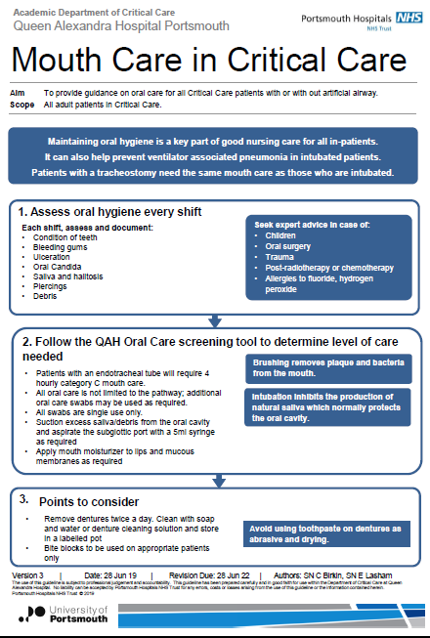

Slide 12
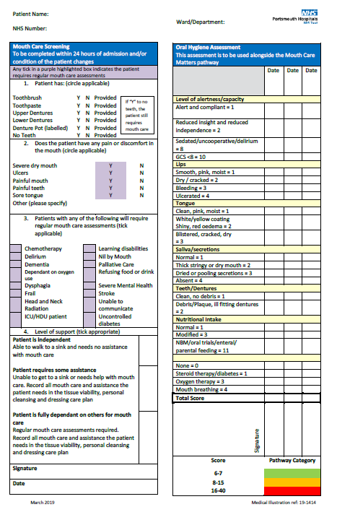

Slide 13
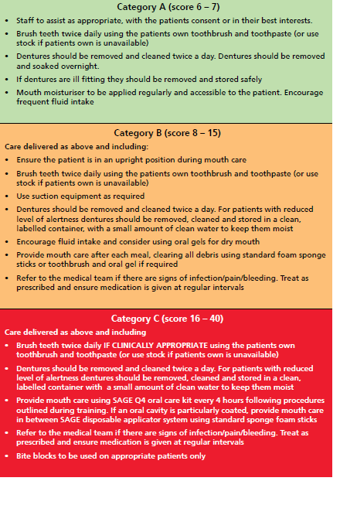

Slide 14
Attending Oral Hygiene
Ensure the patient is placed in an upright/fowlers position.
Attend hand hygiene by either hand washing or using ABHR.
Don PPE, as per Healthcare Associated Infection Procedure on the policy register.
Assess the oral cavity.
Allow or assist the patient to clean teeth/dentures or clean and massage the gums, teeth, tongue with sodium bicarbonate or mouthwash soaked swabs.
Place dentures in a denture cup clearly labelled with the patient’s details when not in use.
Ensure the patient’s mouth is clear of excess toothpaste (encourage patient to spit in a disposable cup). Rinsing after cleaning is not recommended.
Apply lip balm and aerosol spray as indicated.
Replace dentures as appropriate.

Slide 15
Rinse toothbrush and remove excess water with disposable paper towel. Store in an appropriate container that allows bristles to dry.
Discard single use equipment into clinical waste receptacle.
Attend hand hygiene by hand washing or using ABHR
Document in patient’s clinical record:
Description of the oral cavity
Type of mouthwash and toothpaste used
Signs of skin breakdown or infection
Report any concerns to the Medical Officer and/or visiting oral health therapist where appropriate.

Slide 16
Recommended fluoride concentration :
toothpaste Fluoride concentration can be found on the back of most toothpaste tubes in the ingredients list and will be listed as, for example, 1000 ppmf (parts per million fluoride) For patients at increased caries risk (considered to be the case if hospital in-patient requiring assistance in daily oral hygiene activities):
0-3 years Smear of toothpaste containing 1350-1500ppm fluoride
3 –9 years Pea-sized amount of toothpaste containing 1350-1500ppm fluoride
Age 10+ and adults Pea-sized amount of toothpaste containing1350-1500ppm fluoride or consider higher strength preparations
*Toothpaste with higher concentrations of fluoride (2,800ppm and 5,000ppm) should be used under the guidance of a dental surgeon.

Slide 17
Specific Oral Hygiene Problems/Interventions
Stomatitis | General oral hygiene | 4 hourly and as required (PRN)
Gingivitis/glossitis | Brushing/mouthwashes | 4 hourly and PRN
Xerostomia | Mouthwashes/Aerosol | 4 hourly and PRN
Ulceration | Mouthwashes/massage | 3 times a day/after meals
Halitosis | Brushing/mouthwashes | 4 times a day and PRN
Note:
Caution with patients with a low platelet count of <20000, as vigorous brushing may cause bleeding. Caution with patients who have had facial reconstruction surgery, facial fractures or fractured mandible.

Slide 18
Eye care in hospital
Predictors of Nurses’ Practice of Eye Care for Patients in Intensive Care Units
Sana Lami, MSN¹ and Ahmad Ayed, MSN, PhD ²
Author information Article notes Copyright and License information PMC Disclaimer
Results
The The analysis revealed that only 0.7% had a good knowledge level, 7.2% had a fair knowledge level, and 25.7% had a good practice level of eye care for patients in an ICU. Knowledge of patients’ eye care in the ICU, as well as an eye care protocol or policy for unconscious patients, was found to be significant predictors of practice (p < .001).
Conclusion
The study confirmed that the nurses had poor knowledge and inadequate practice of eye care for patients in the ICU. Also, the study confirmed that a nurse's knowledge of patients’ eye care in the ICU and an eye care protocol or policy for unconscious patients were significant predictors of practice.

Slide 19
بهداشت قسمت قدامی چشم ها بخصوص قرنیه به توانایی تولید اشک ، پلک زدن و بستن چشم ها در حالت بیداری و خواب ارتباط دارد . اختلال در موارد ذکر شده در ICU بعلت ادم صورت ، کاهش سطح هوشیاری ، آسیب عصبی محیطی یا مرکزی میتواند سبب آسیب به چشم شود .علاوه بر این اکسیژن تجویز شده از طریق ماسک یا CPAP میتواند سبب خشکی چشم ها شود .شل کننده های عضلانی میتوانند سبب کاهش توانایی پلک ها جهت بسته شدن شوند .sedation میتواند سبب ضعیف شدن رفلکس پلک زدن شود . اثرات طولانی مدت ماندن در پوزیشن prone میتواند آسیب چشم ها را بدنبال داشته باشد .این اختلالات در بیماران تحت تهویه مکانیکی میتواند شدیدتر باشد .تهویه با فشار مثبت ، افزایش مدت زمان بستری ، استفاده از داروهای آرام بخش و پارالیتیک میتواند سبب افزایش احتمال آسیب چشمی در بیماران شوند .

Slide 20
عوارض عمده چشمی در بخش ICU شامل :
1- آسیب مستقیم به قرنیه
2- کراتوپاتی exposure keratopathy
3- کیموزیس یا ادم ملتحمه
4- کراتیت یا کنژوکتیویت باکتریال
بسته شدن پلک ها و ظاهر پلک ها باید بطور منظم با یک نور مناسب در هر شیفت کاری کنترل شود و هر گونه وضعیت غیر طبیعی چشم باید گزارش شود . بسته شدن ناکامل پلک ها lagophthalmos گفته میشود .

Slide 21
Protective measures The action required is based on the grading of exposure:
• Grade 0 exposure (i.e. no exposure) requires no action.
پلک بطور کامل بسته میشود .
• Grade 1 exposure requires lubrication
هر گونه نمایان بودن ملتحمه ( صلبیه چشم نمایان ولی قرنیه پیدا نباشد )
Grade 2 exposure needs lubrication and taping of the lids or other method of lid closure.
هر گونه نمایان بودن قرنیه حتی اگر میزان آن کم باشد

Slide 22
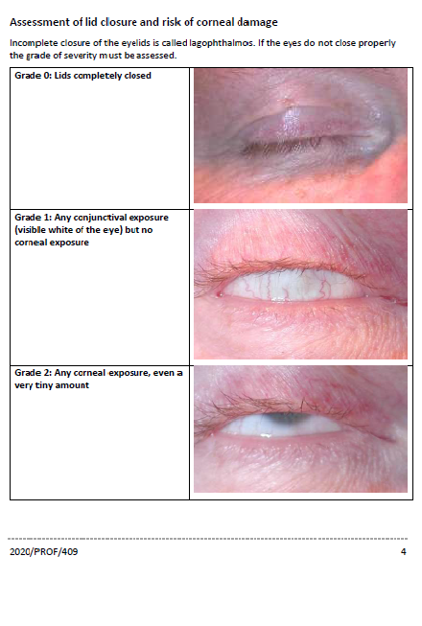

Slide 23
The methods to protect the eyes are:
• Lubrication. Liberal use of ointment lubricants into the eye four times daily e.g. simple eye ointment, Lacrilube , Xailin Night, and VitA-POS). Drops do not last as long. This needs to be applied correctly into the eye and not, as is sometimes found, over closed eyelids. Such action is superior to manual eye closure alone3. o If a patient is conscious an alternative is 2 hourly lubricant drops (e.g. Hylotears) and ointment before sleep.

Slide 24
• Closing the eyelids. o Manual closure of the eyes o Taping the eyes shut. Lid taping is not always necessary and can be distressing to relatives and to conscious patients, and repeated removal may lead to facial skin or eyelid injury or irritation. It should therefore only be undertaken when necessary. It is crucial when using taping that the lids are completely shut and the tape not touching the eye surface as more damage will be done than prevented. o Cling film can be used as a safe alternative to tape to protect the eye – it does not cause damage if in contact with the eyeball. Apply a 10x10cm square over each eye and change every shift. Never share a cling film roll between patients. o Hydrogel or silicone dressings or pads (eg Kerrapro, Gelliperm) may be used instead of taping, if oedema prevents manual lid closure. They should be changed once per shift and must not be allowed to dry out or position poorly as this can damage the eye. Only use with great care to avoid causing eye damage. What order to do this: Every 4 hours:

Slide 25
• Bathe the eyes with warm water first to remove dried ointment.
• Before the next lubricant application, examine the eye for abnormalities with a bright light.
Apply new ointment to the eye surface: pull the lower eyelid down with a finger and insert the ointment over the top of the lower lid into the gap between the lid and the conjunctiva.

Slide 26
– If taping is also performed, ointment is put in first and the eyes are closed7, 8, 9. The position of the lashes is then checked as the lashes must be clear of the cornea if iatrogenic corneal abrasion is to be avoided). The outside of the eye must be free of the lubricant ointment for tape to stick properly. Micropore tape is then applied horizontally across the lids to seal them shut as below:
Prone unconscious patients. In those patients nursed prone and unconscious, the eyelids and face can become oedematous and conjunctival swelling (chemosis) is common. As in all ventilated patients, exposure keratopathy (a drying of the corneal surface, see below) can occur10, 11. Direct eye compression can occur and can be avoided using a 3-pin head holder as is used for prone spinal surgery12, gel rings or similar devices. The eyes should always be re-lubricated every 4 hours, and taped or cling-filmed shut as above. Where there is severe oedema and the swollen conjunctiva prolapses through the closed eyelids, the medical staff should be contacted as the eyelids may need to be temporarily closed with sutures.

Slide 27
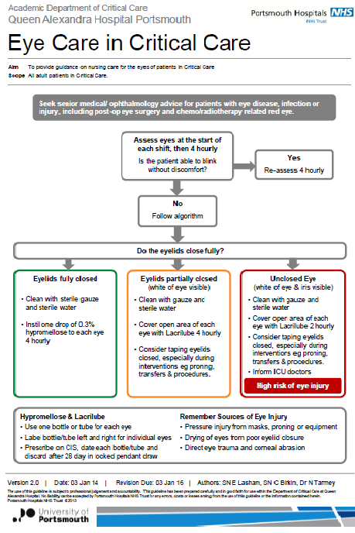
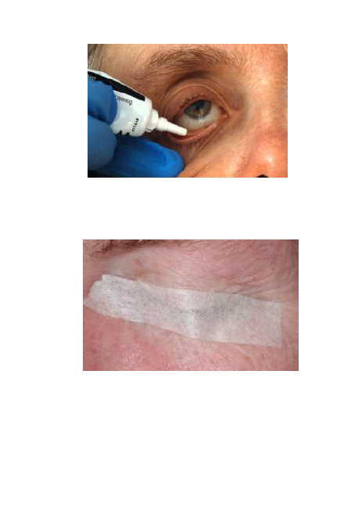

Slide 28
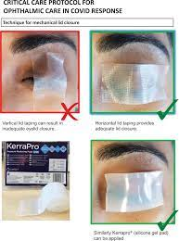
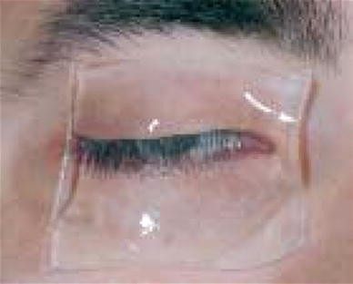

Slide 29

با تشكر از توجه شما

